Slide 1

Department of Computer Engineering
Parity generator and checker
1

Slide 2
Points covered
Department of Computer Engineering
Parity generator
Parity checker
Designing parity generator
Designing parity checker
Application
2

Slide 3
Department Vision & Mission
Department of Computer Engineering
Vision
Achieve academic excellence through education in computing, to create intellectual manpower to explore professional, higher educational and social opportunities.
Mission
To impart learning by educating students with conceptual knowledge and hands on practices using modern tools, FOSS technologies and competency skills there by igniting the young minds for innovative thinking, professional expertise and research.
3

Slide 4
Terms
Department of Computer Engineering
Parity Generator: is a combinational logic circuit that generates the parity bit in the transmitter.
Parity Checker: is a circuit that checks the parity in the receiver.
A combined circuit or devices of parity generators and parity checkers are commonly used in digital systems to detect the single bit errors in the transmitted data word.
Even Parity: the added parity bit will make the total number of 1s an even amount
Odd parity: the added parity bit will make the total number of 1s odd amount.

Slide 5
Department of Computer Engineering

Slide 6
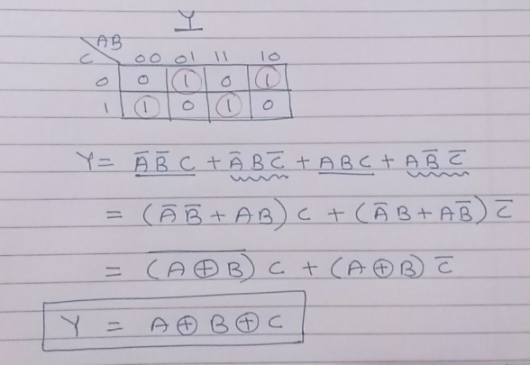
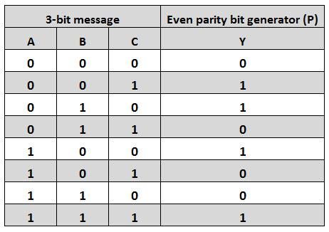
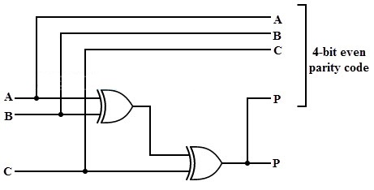
Even Parity Generator
3-bit message is to be transmitted with an even parity bit
K-Map Simplification
Truth Table:
Circuit Diagram

Slide 7
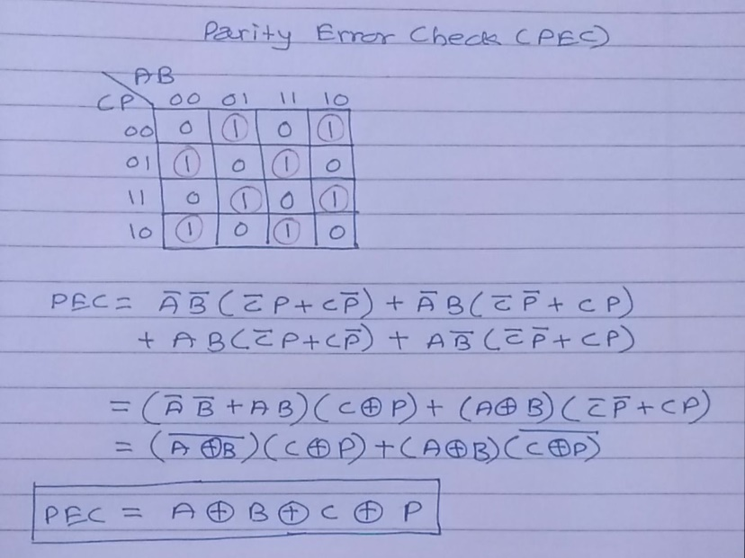
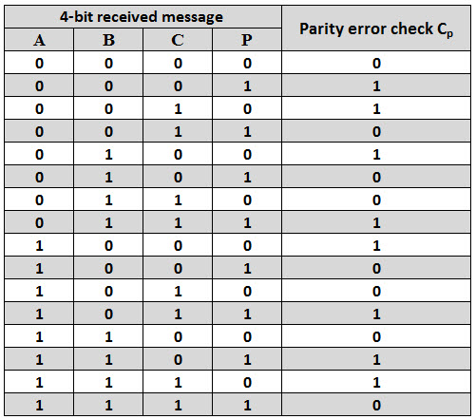
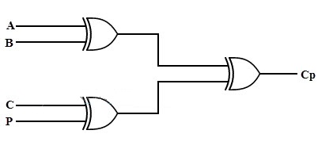
Even Parity Checker
K-Map Simplification
Truth Table:
Circuit Diagram

Slide 8
Odd parity generator and checker
3-bit message is to be transmitted with an odd parity bit
Truth Table
K-Map Simplification
Circuit Diagram

Slide 9
Quiz
Please click the following link to open the quiz
https://forms.office.com/Pages/ResponsePage.aspx?id=PaYKCtCCoUu5CdeYbs5MTF_APCNoJBJKm6RQWrSY69tUQkg2MExMNk40SUNSMzRWN09GM0Q4N0gxMy4u

Slide 10
Points covered
Department of Computer Engineering
Parity generator
Parity checker
Designing parity generator
Designing parity checker
Application
10

Slide 11
Department of Computer Engineering
Thank you

